Slide 1
An Implementation and Exploration of Seam Carving
Logan Donaldson & Jeremy Wang

Slide 2
What is Seam Carving?
Seam carving is a content-aware method of changing the aspect ratio of an image while making is smaller
Seam Carve
Seam Carve
Seam Carve
Original Image

Slide 3
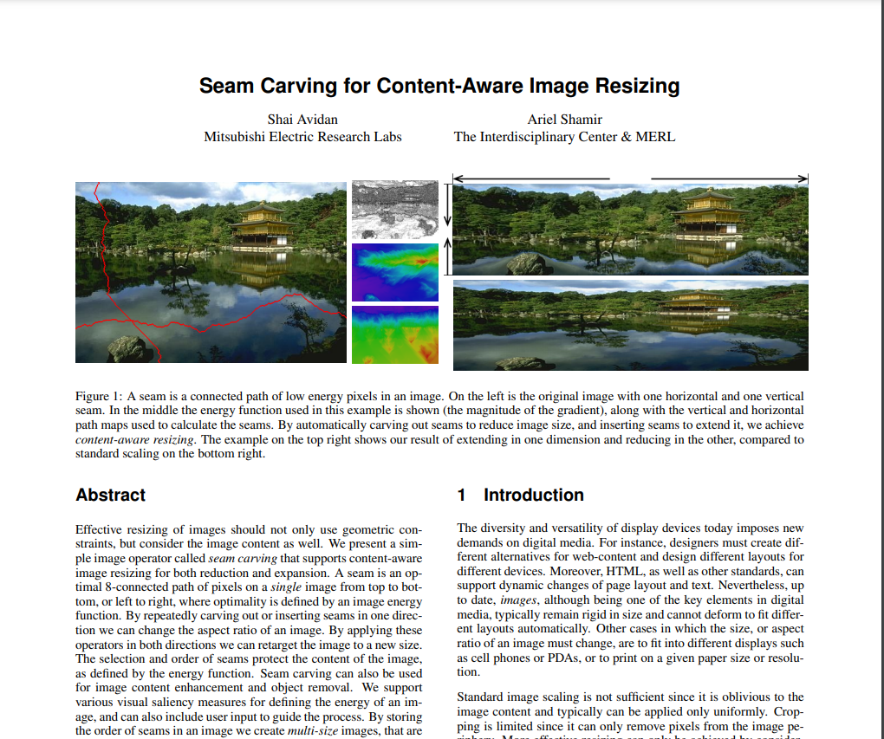
When was seam carving introduced?
Seam carving was introduced in a 2007 paper co-authored by Shai Avidan and Ariel Shamir

Slide 4
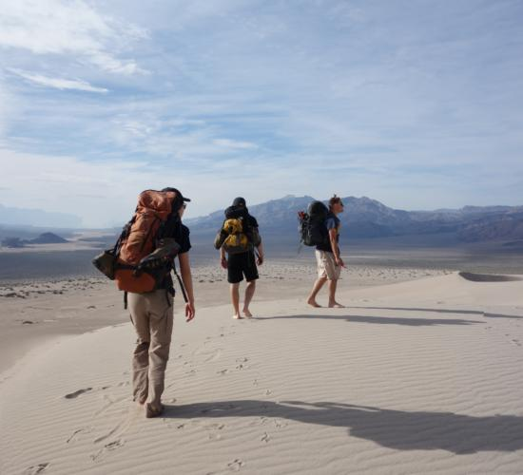
Why use seam carving?
Traditional methods of image dimension reduction either deform the image (simple-rescaling) or lack flexibility (cropping)
Original Image
Simple-Rescaling
Cropping

Slide 5
What is the seam carving algorithm?
Compute an energy function over the input image
Find the seam with the lowest cumulative energy
Remove the seam
Repeat steps 1-3 until the desired number of seams are removed

Slide 6
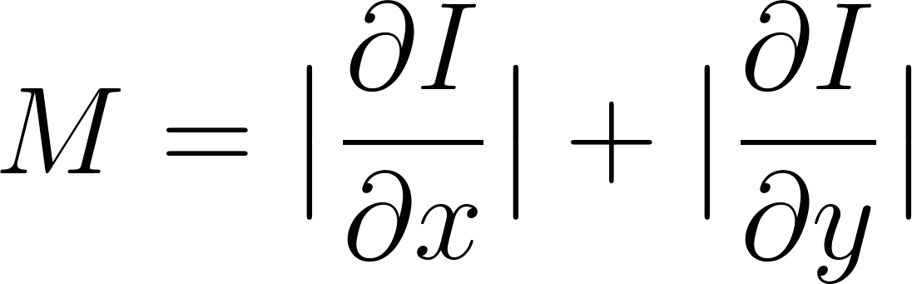
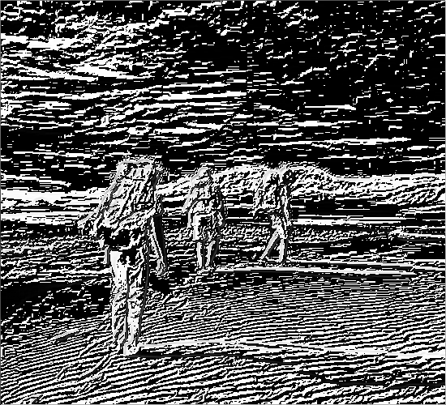
What is an energy function?
An energy function takes an image I∈𝐑^{nxm} as input and outputs and energy map M∈𝐑^{nxm}. Large values of M correspond to “interesting” regions of the image.
One can choose a variety of energy functions. We begin with:
or the L1 Norm, where the partial derivatives are computed using Sobel filters

Slide 7
What is a seam?
A seam is a sequence of connected pixels spanning the width (or length) of an image
We remove the seam whose pixels have the lowest energy sum

Slide 8
How do we create the seam in practice?
123
130
128
141
139
123+90=213
123+27=150
128+25=153
128+23=151
139+51=190
150+31=181
150+26=176
150+9 =159
151+10=161
151+56=207
Notes:
We take a bottom up approach

Slide 9
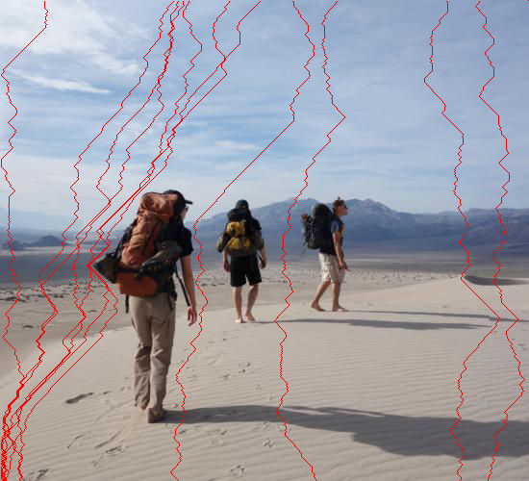
Examples of Seams

Slide 10
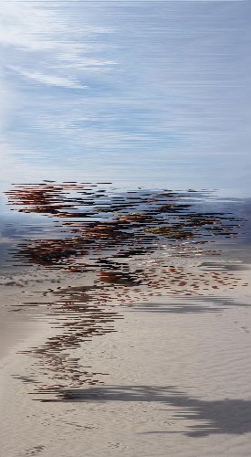
Why must the seams be connected?
If we were to simply remove the pixel with the lowest energy from each row the result would have extreme artifacts
Original Image
Removing Unconnected Pixels

Slide 11
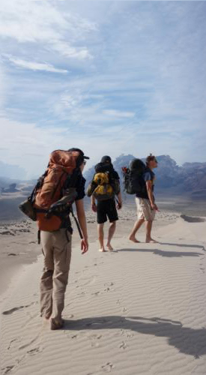
Original Image
Simple-Rescaling
Cropping
Seam Carving

Slide 12
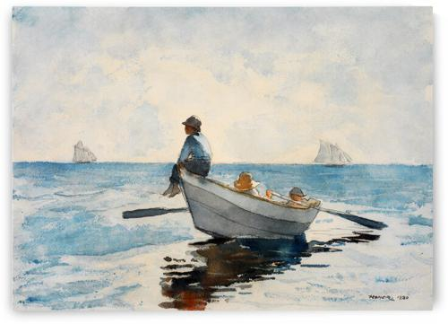


Slide 13
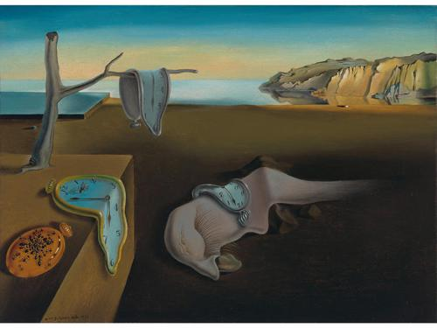
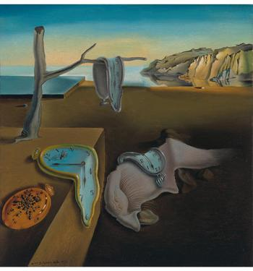

Slide 14
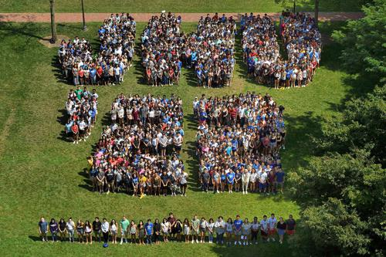
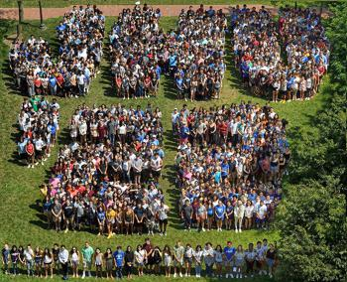

Slide 15
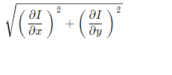
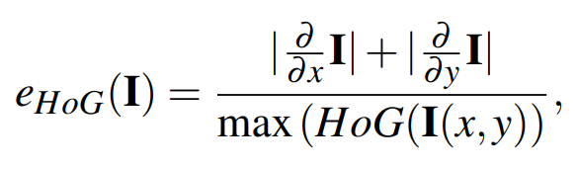
Other Energy Functions Considered
L2 Norm
Harris Corner Detector
Histogram of Gradients

Slide 16
Histogram of Gradients (HoG)
Calculate Gradient of the Image
Calculate Histogram of Gradients within MxN cells and X bins.
We use an 11x11 window and 8 bins
Direction determines which bin, magnitude is placed in that bin
Normalize across blocks
We normalize histogram values across a 1x1 block, which is just a cell
An optional feature vector can be calculated

Slide 17
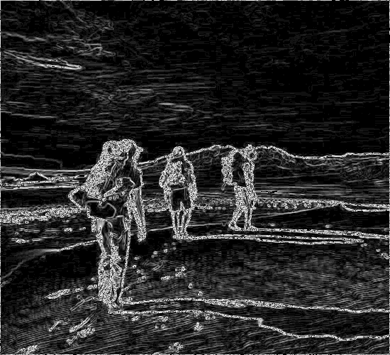
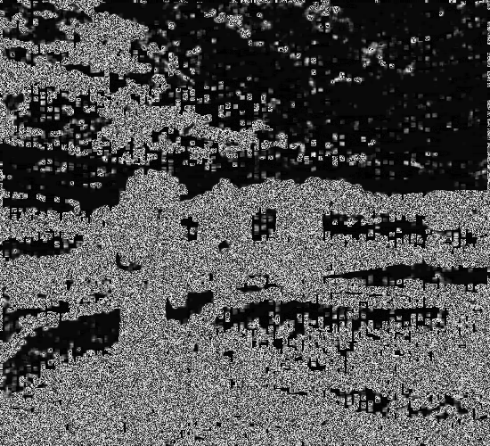

Other Energy Functions Considered
L2-Norm
Harris Corner Detector
Histogram of Oriented Gradients

Slide 18





Comparison of Energy Functions
L1 Norm
L2 Norm
Original
Harris Detector
HoG

Slide 19
Enlarging Images
We can use a similar method to change the aspect ratio of an image while making it larger
To increase the width of our image by n pixels we do the following,
Find the first n seams for removal
Add pixels along these seams in the reverse order in which they would have been removed

Slide 20



Slide 21
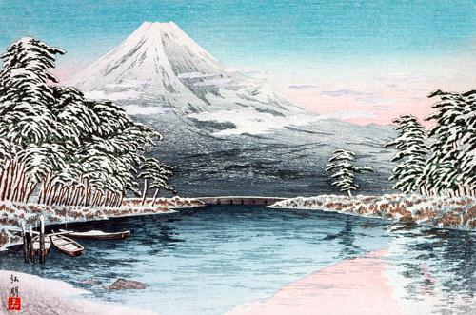
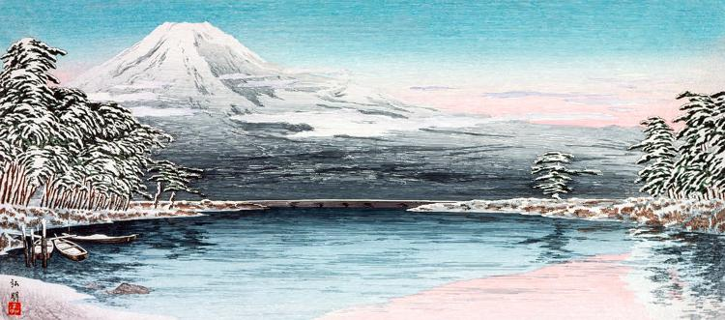

Slide 22
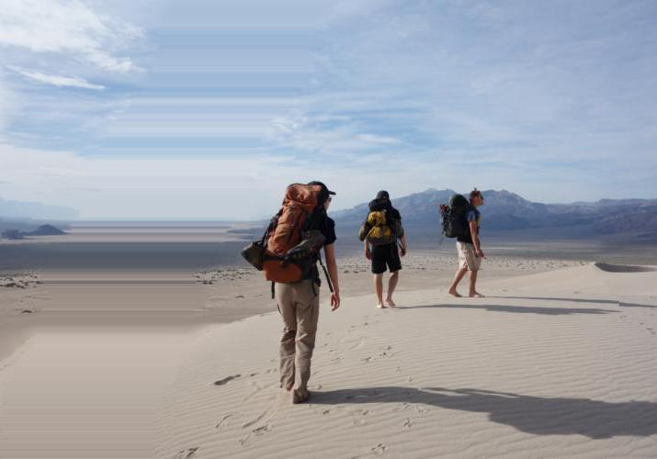
Why not always insert at the lowest energy seam?
Remember that we insert pixels along the first n seams which would have have been removed
If instead always inserted along the lowest energy seam then the same seam would be repeatedly chosen leading to a smearing effect

Slide 23
Is Seam Carving Magic?
No!
Seam carving does not work well when,
The image is too full with “interesting” things
The “interesting” things span the width (or length) of the image
The “interesting” things do not have high energy

Slide 24



Slide 25

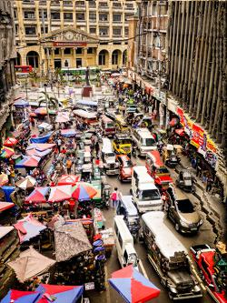

Slide 26
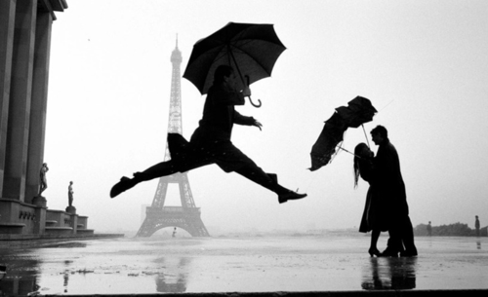
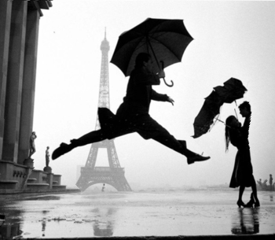

Slide 27
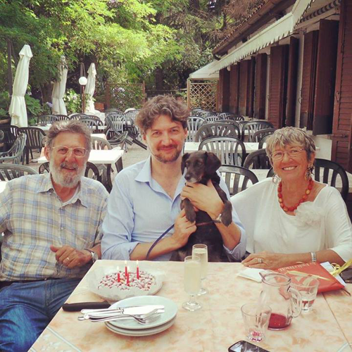
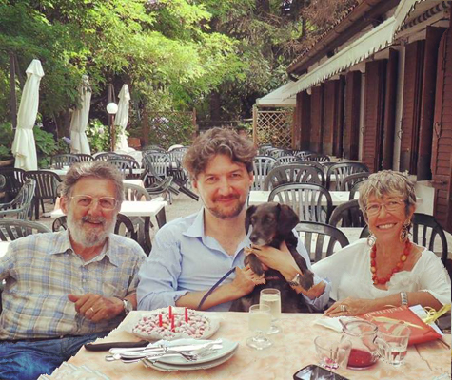

Slide 28
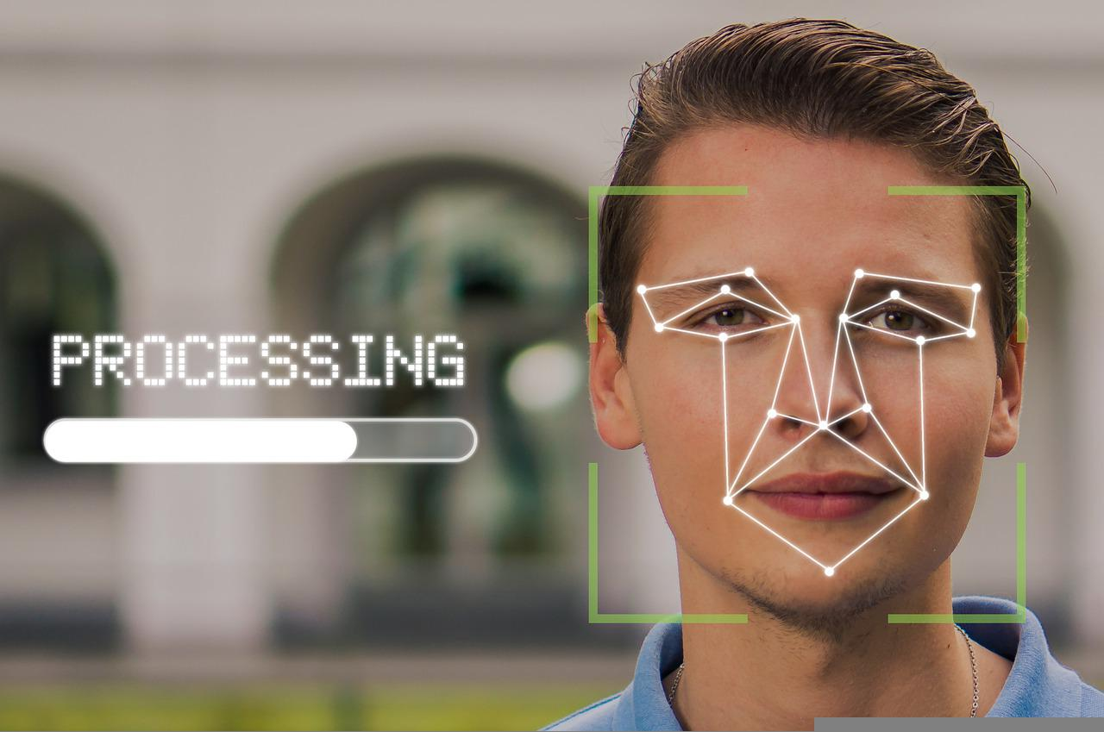
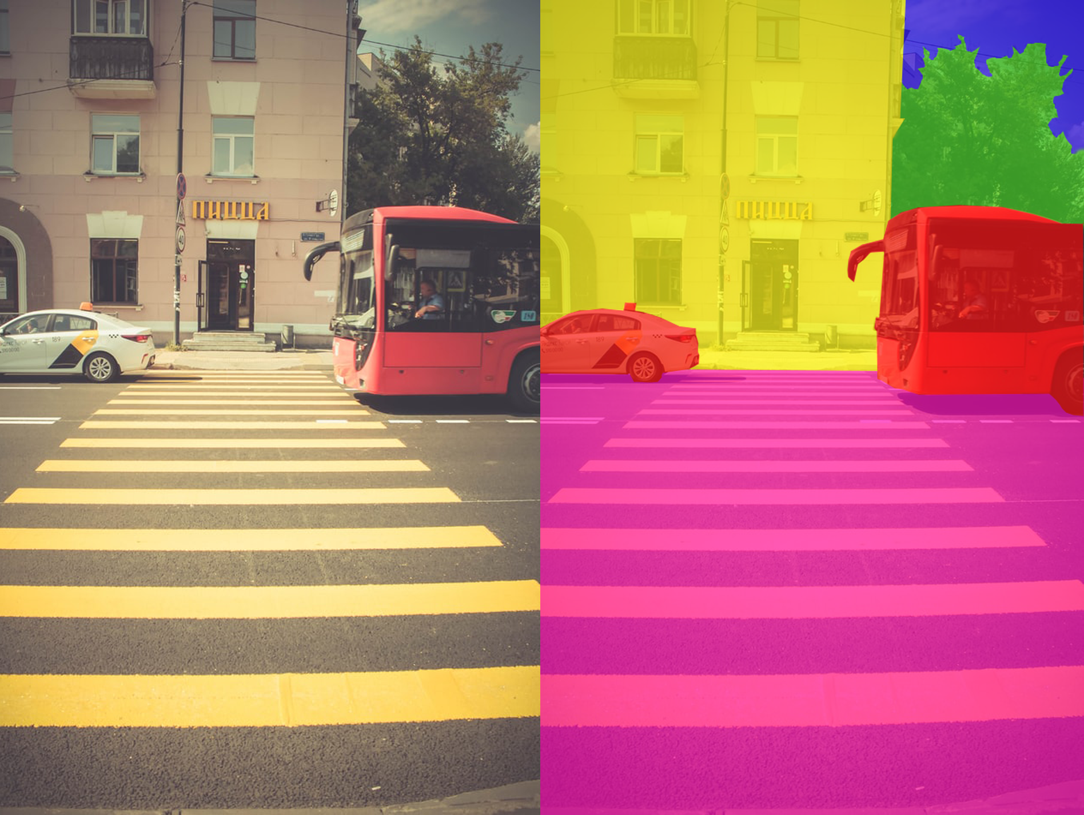
What are potential solutions?
Use a more sophisticated energy function such as a face detector
Allow the user to indicate pixels that should not be removed

Slide 29
Improvements & Future Directions
One possible improvement is considering forward energy. When a seam is removed it brings previously non-adjacent pixels together, which can inadvertently add high energy edges into the image. Thus, rather that simply remove the seam with the lowest energy one can consider the difference in the total energy of the image after seam removal and before seam removal.

Slide 30
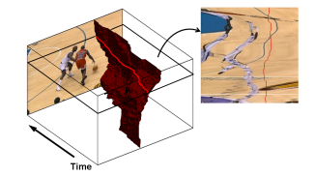
Improvements & Future Directions
Seam carving can be adapted to work across both time and space dimensions so that it can be applied to videos

Slide 32
References
Avidan, S., & Shamir, A. (2007). Seam carving for content-aware image resizing. In ACM SIGGRAPH 2007 papers (pp. 10-es).
N. Dalal and B. Triggs, "Histograms of oriented gradients for human detection," 2005 IEEE Computer Society Conference on Computer Vision and Pattern Recognition (CVPR'05), 2005, pp. 886-893 vol. 1, doi: 10.1109/CVPR.2005.177.
Rubinstein, M., Shamir, A., & Avidan, S. (2008). Improved seam carving for video retargeting. ACM transactions on graphics (TOG), 27(3), 1-9.

